Slide 1
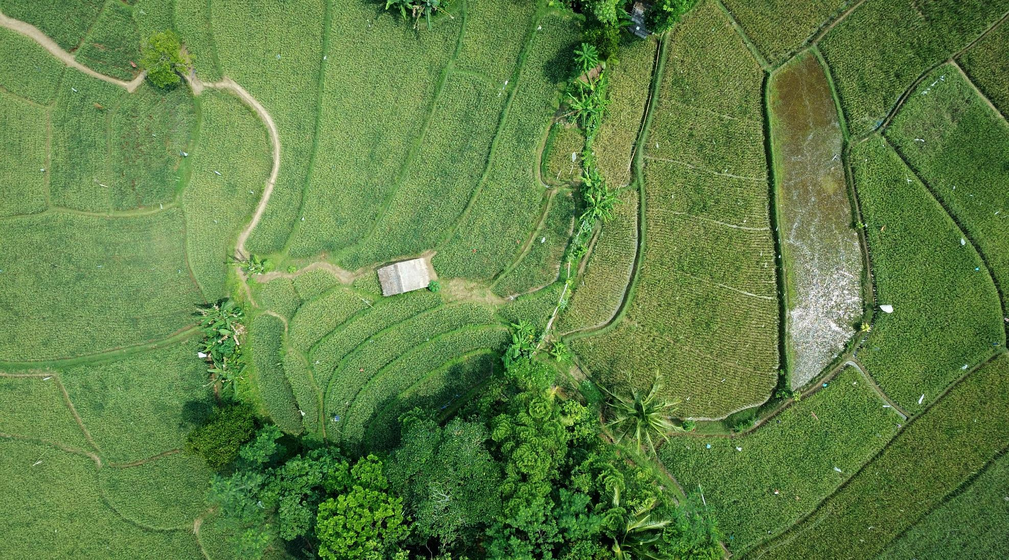

8BIT Solutions
Estimation of Crop Progression

Slide 2
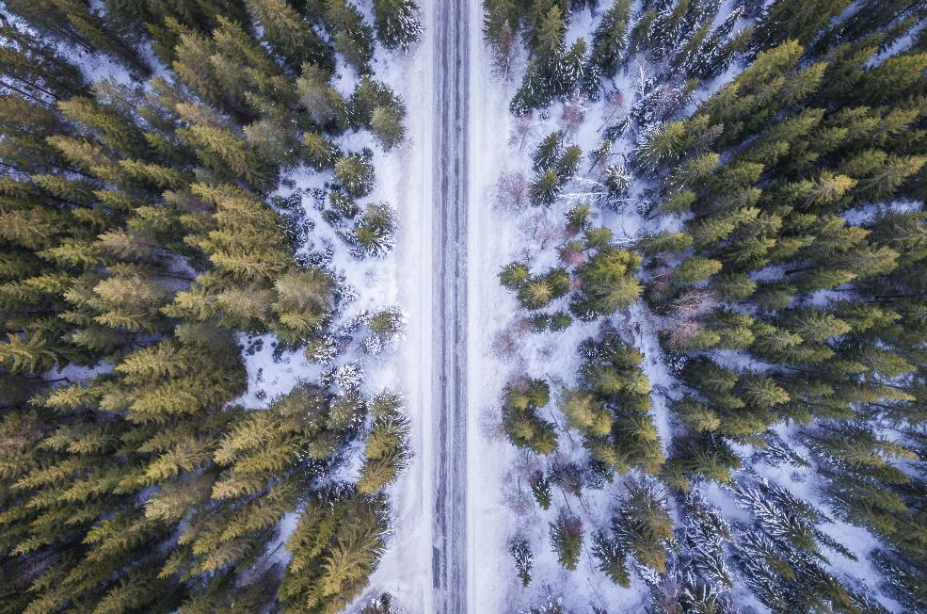
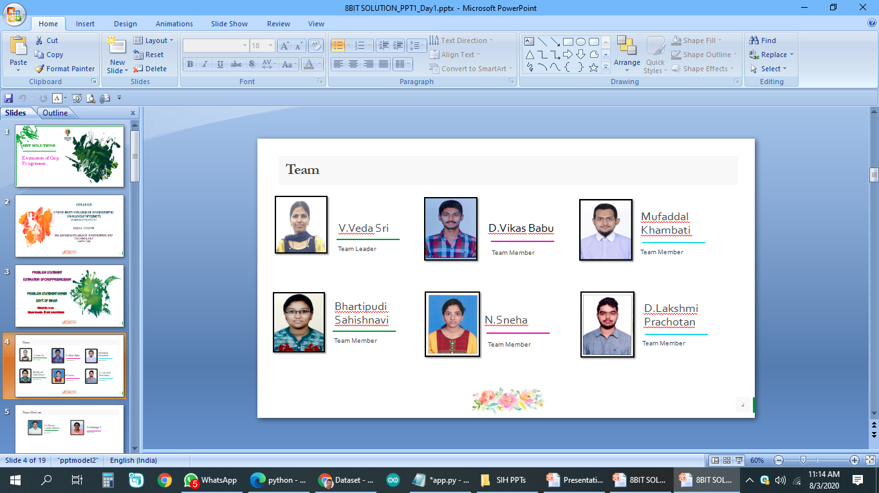
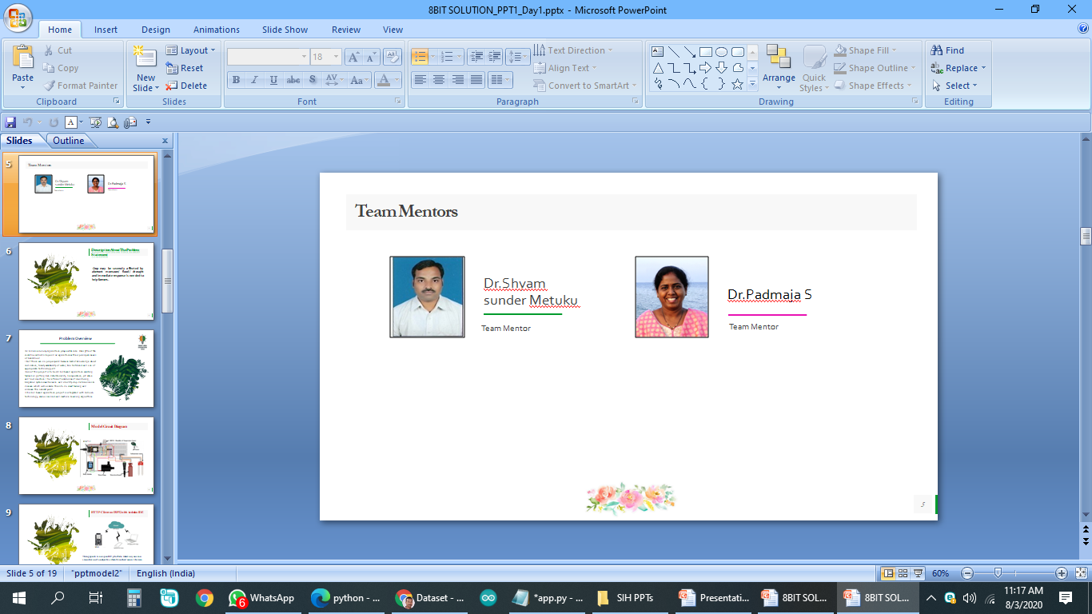
About Us
University College of Engineering
Osmania University
Hyderabad, Telangana

Slide 3

Problem Statement
Estimation of Crop progression
Problem Description
Crop may be severally affected by aberrant monsoon/ flood/ drought and immediate response is needed to help farmers.

Slide 4





The Problem
Changing Climate
Water Shortages
Longer Rainfall/Droughts
New Terrain
Industrial Impact

Slide 5



The Solution
Data Acquisition
Process & Analysis
Predict

Slide 6
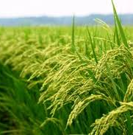



The Product
Web Deep Links
Instant Communication
Networked API

Slide 7
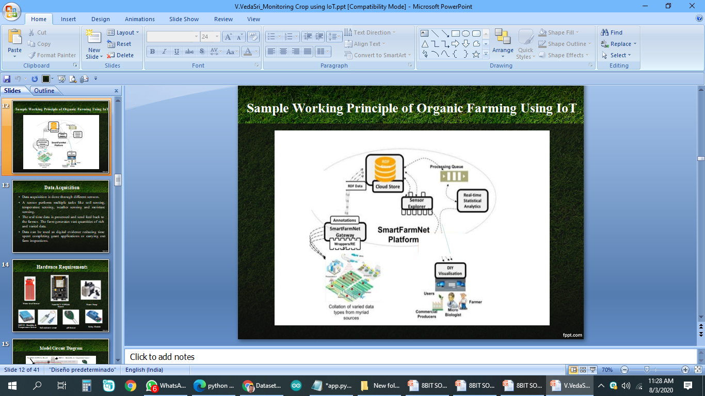
The Product
Working Principle of Smart Farming Using IoT
Web Deep Links
Instant Communication
Networked API

Slide 8
Growth Strategy
How will we scale in the future
Irrigation System
Monitoring the Field
Predict the Diseases and Deficiencies

Slide 9
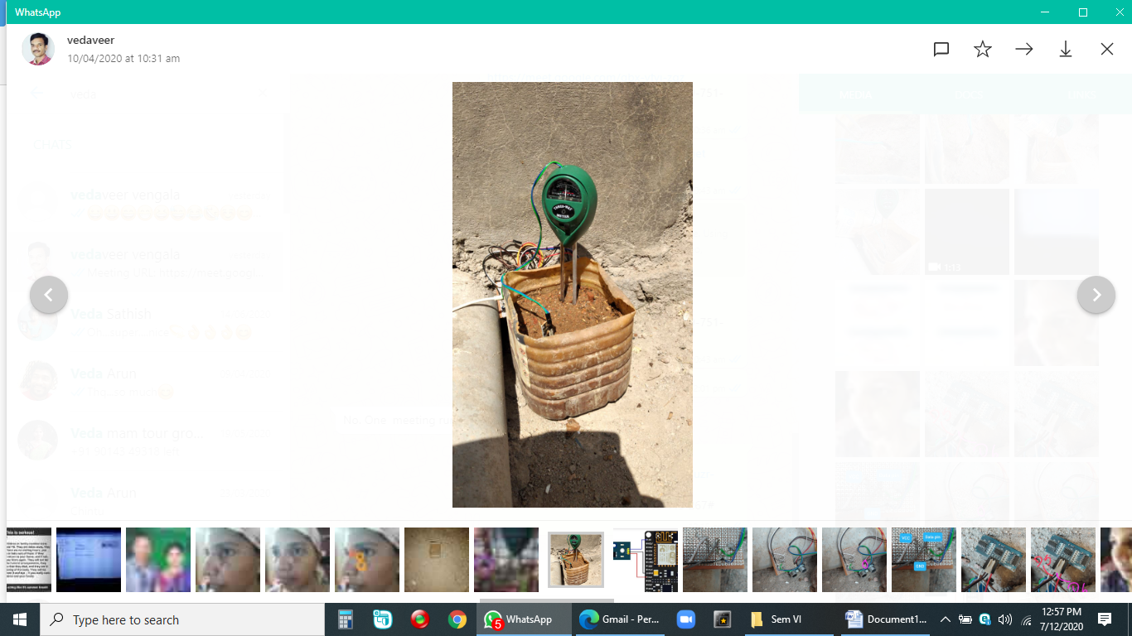
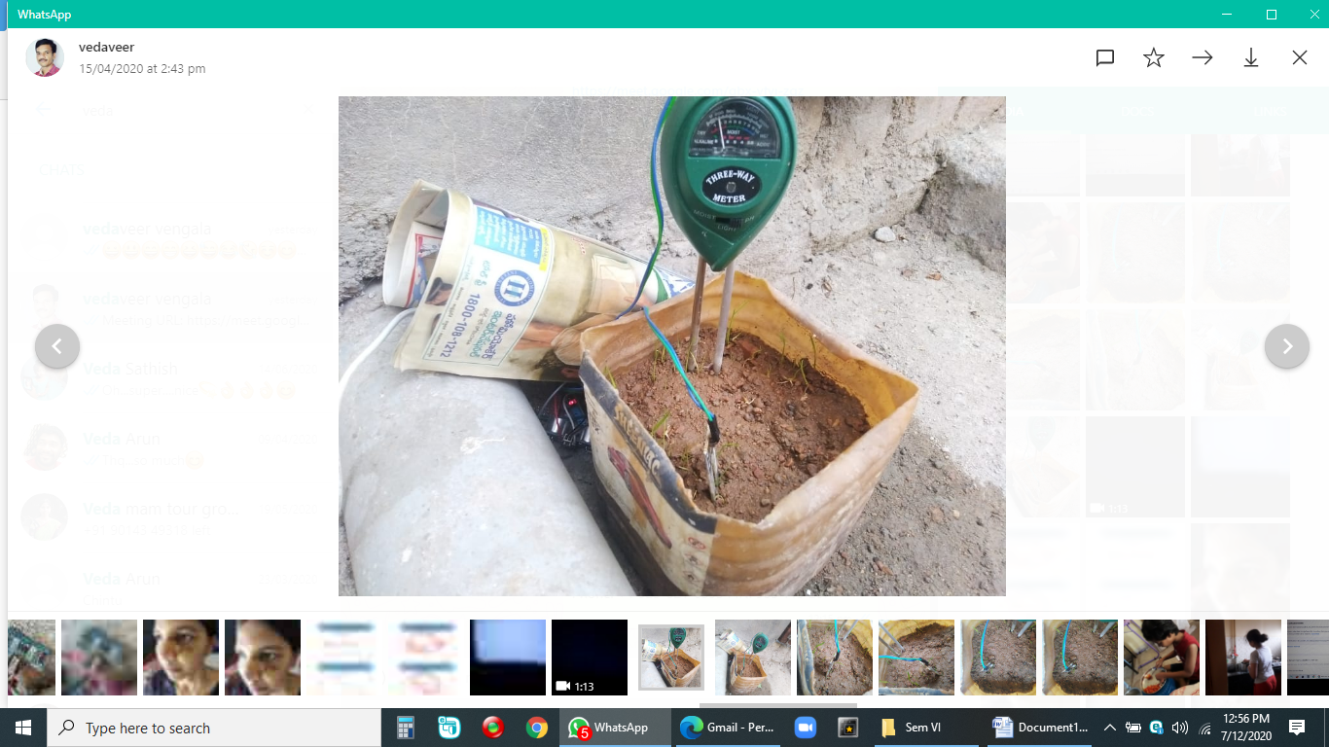
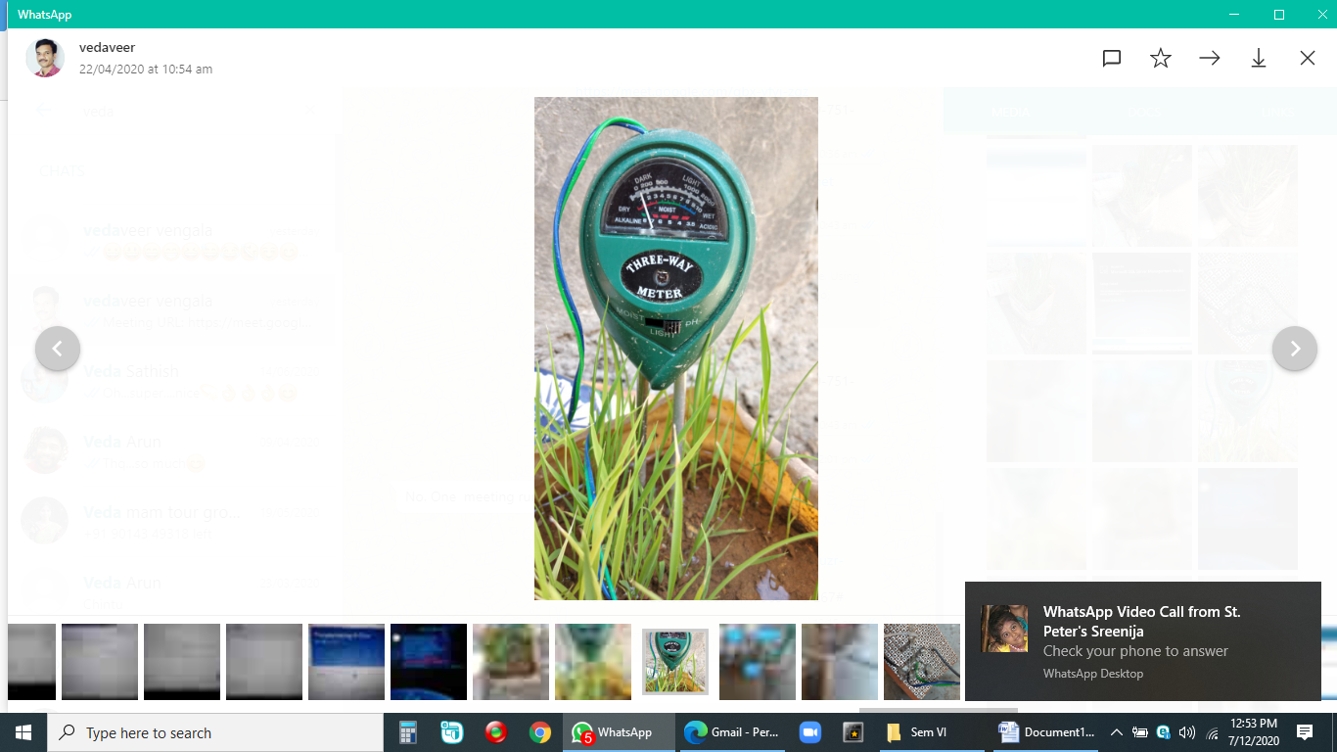
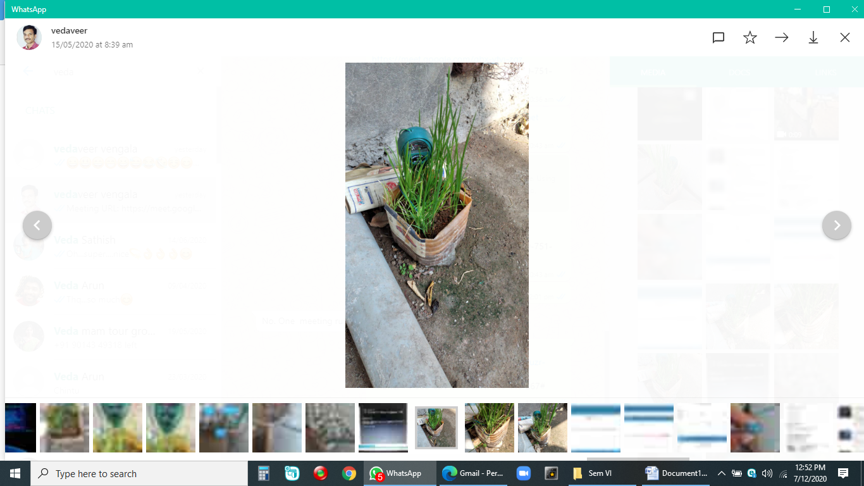
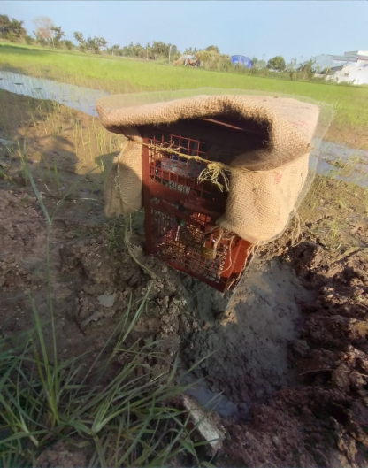
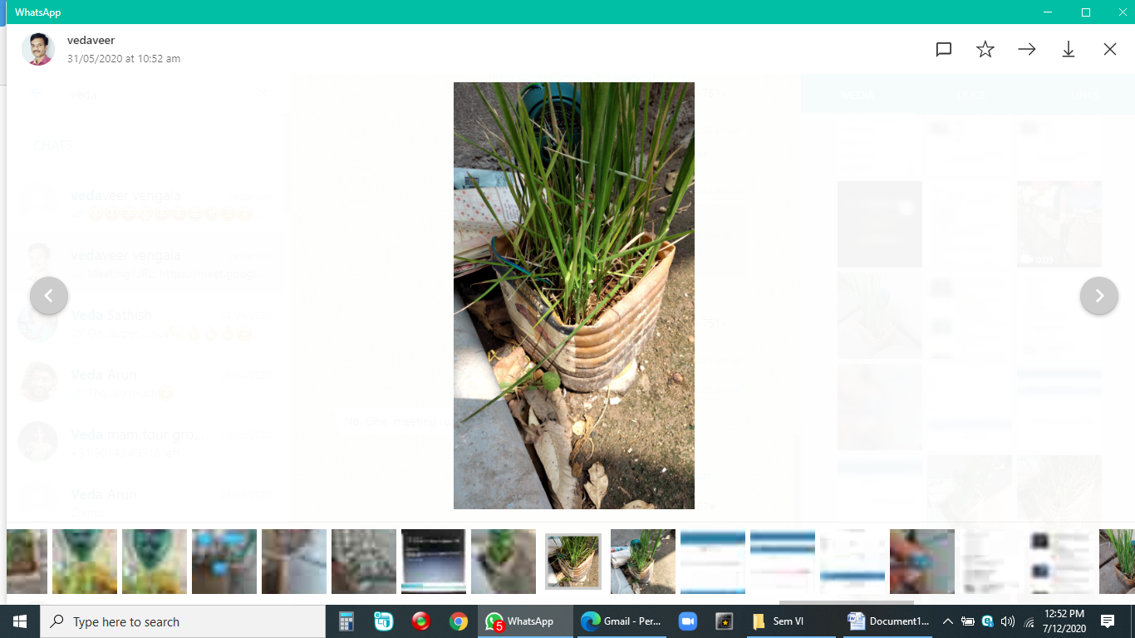
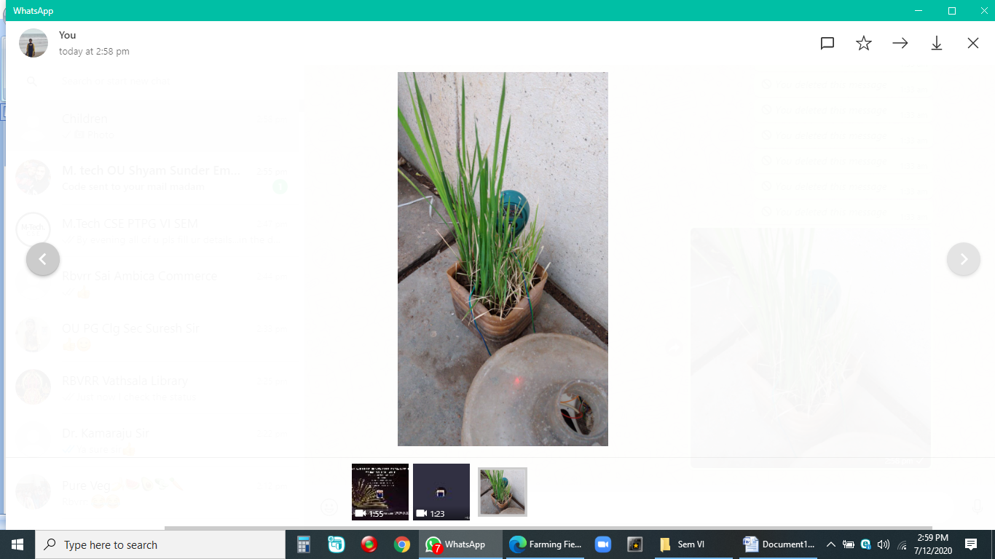
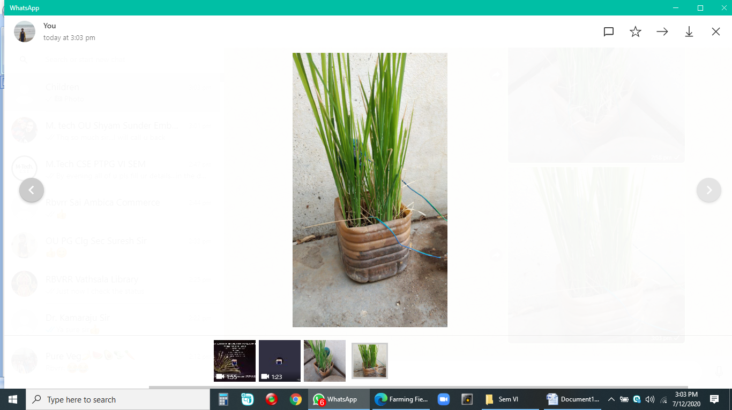
Growth of Rice Crop
9th April, 2020
15th April, 2020
22nd April, 2020
15th May, 2020
31st May, 2020
14th June, 2020
4th July, 2020
Arranged model device at farming land

Slide 10
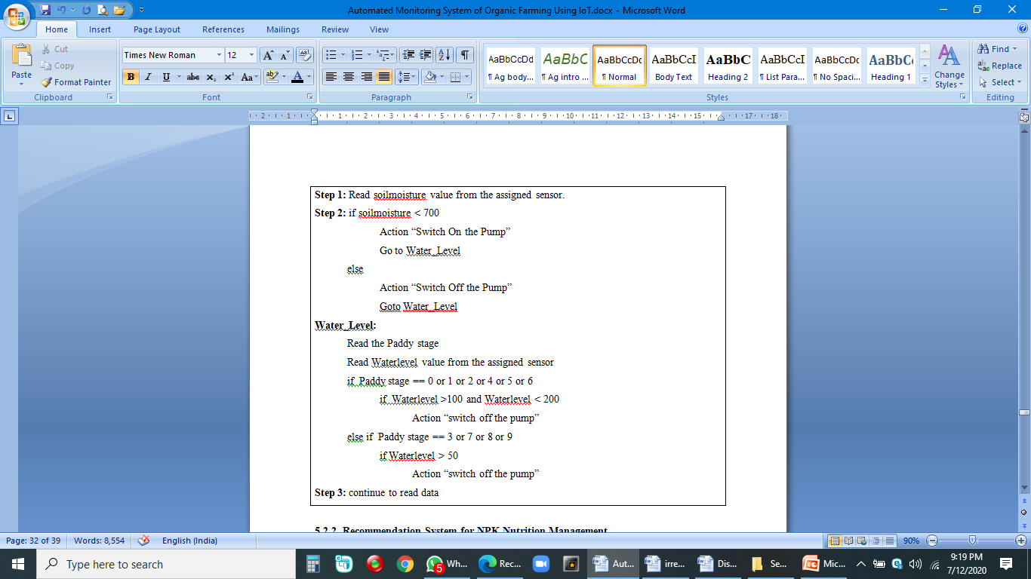
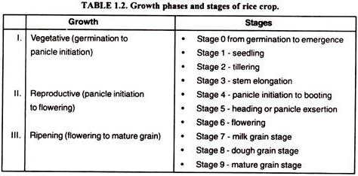
Algorithm for Water Irrigation Management System

Slide 11

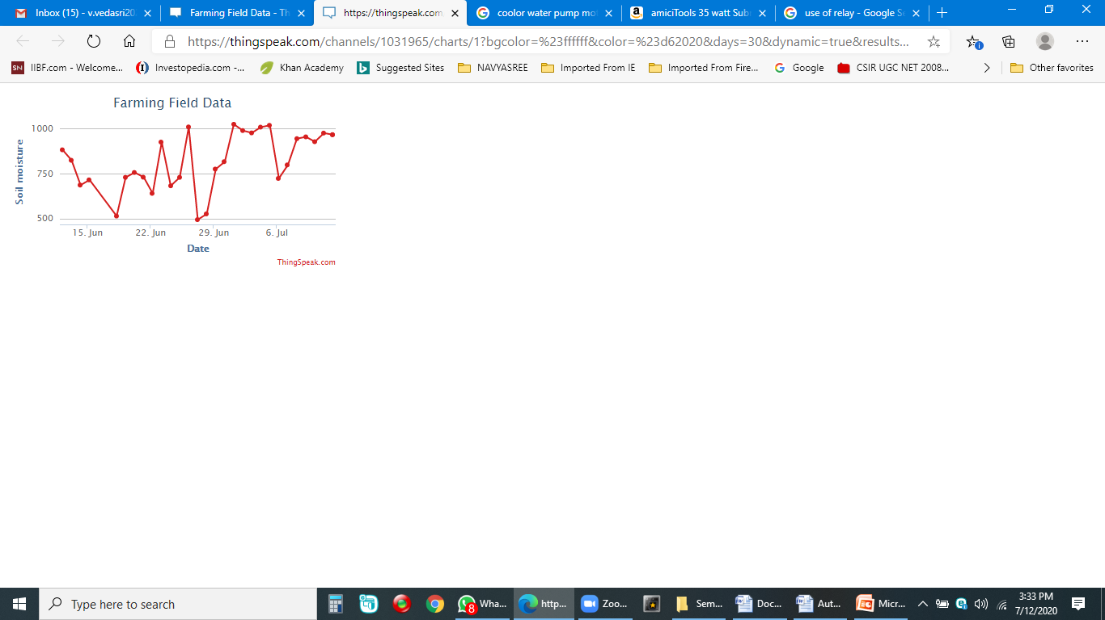
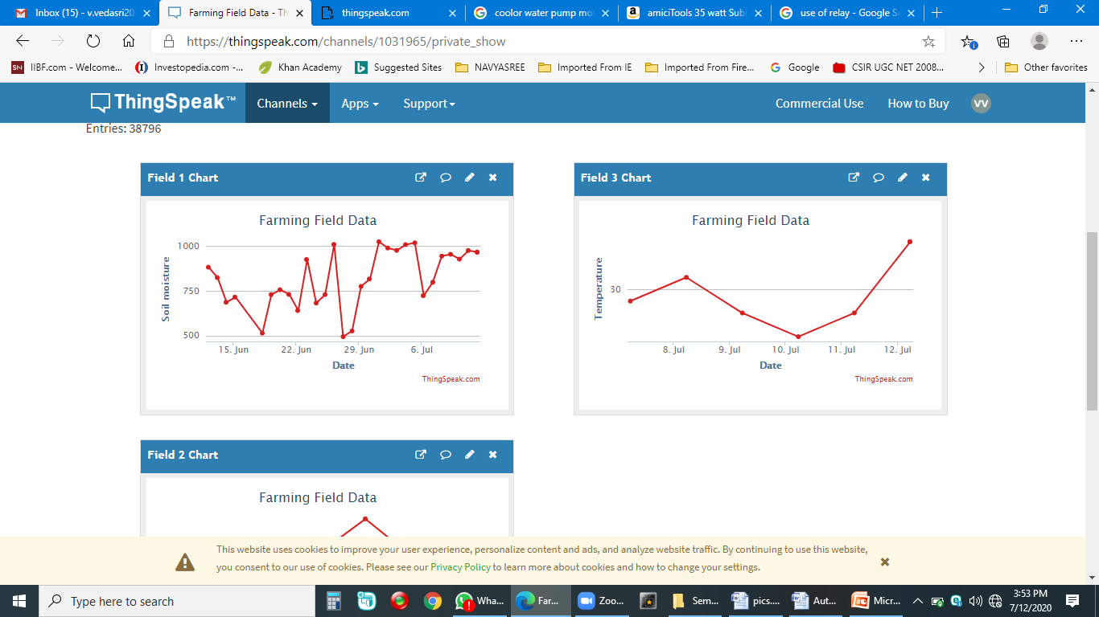
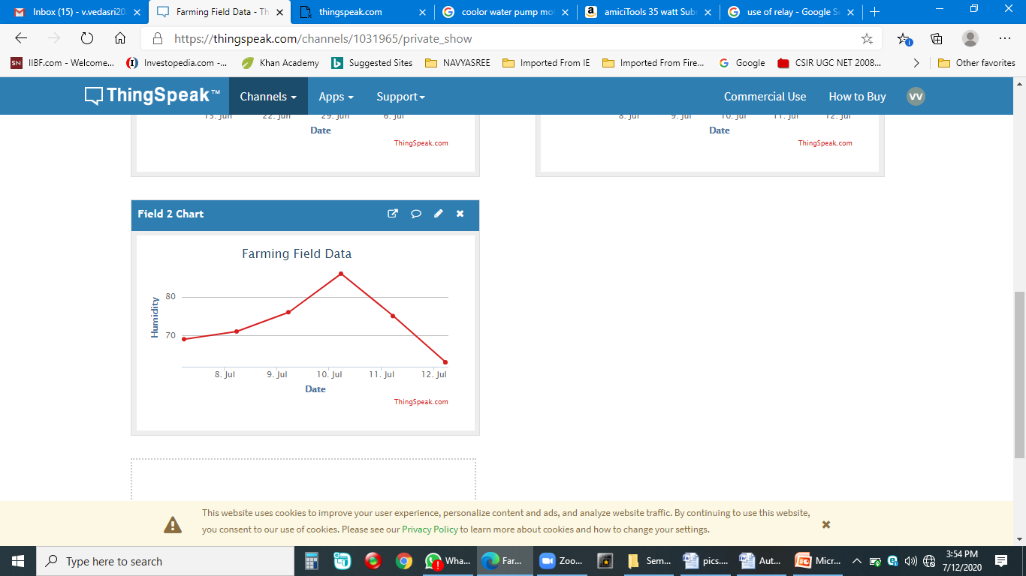
Sensors Data View
Sensors Data View

Slide 12

The objective of the Convolution Operation is to extract the high-level features such as edges, from the input image.
Convolutional Neural Network (ConvNet/CNN)

Slide 13
Coding Part
Rice Diseases classes as : disease_types = ['Bacterial leaf blight','Brown spot','Leaf smut']
Nutrient deficiency classes as:
deficiency_types = ['Nitrogen','Phosphorous','Potassium']

Slide 14
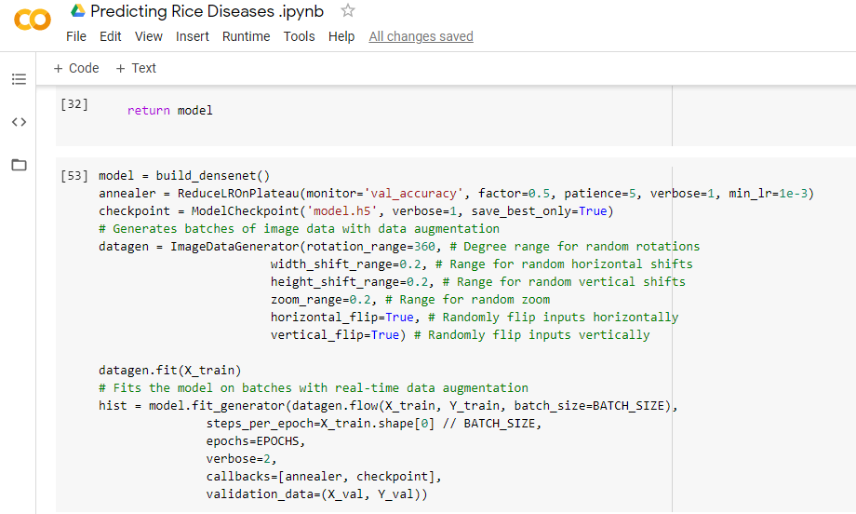
Coding Part for disease identification model:

Slide 15
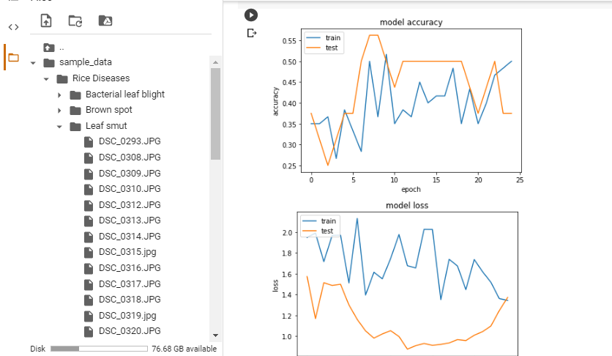
Coding Part

Slide 16
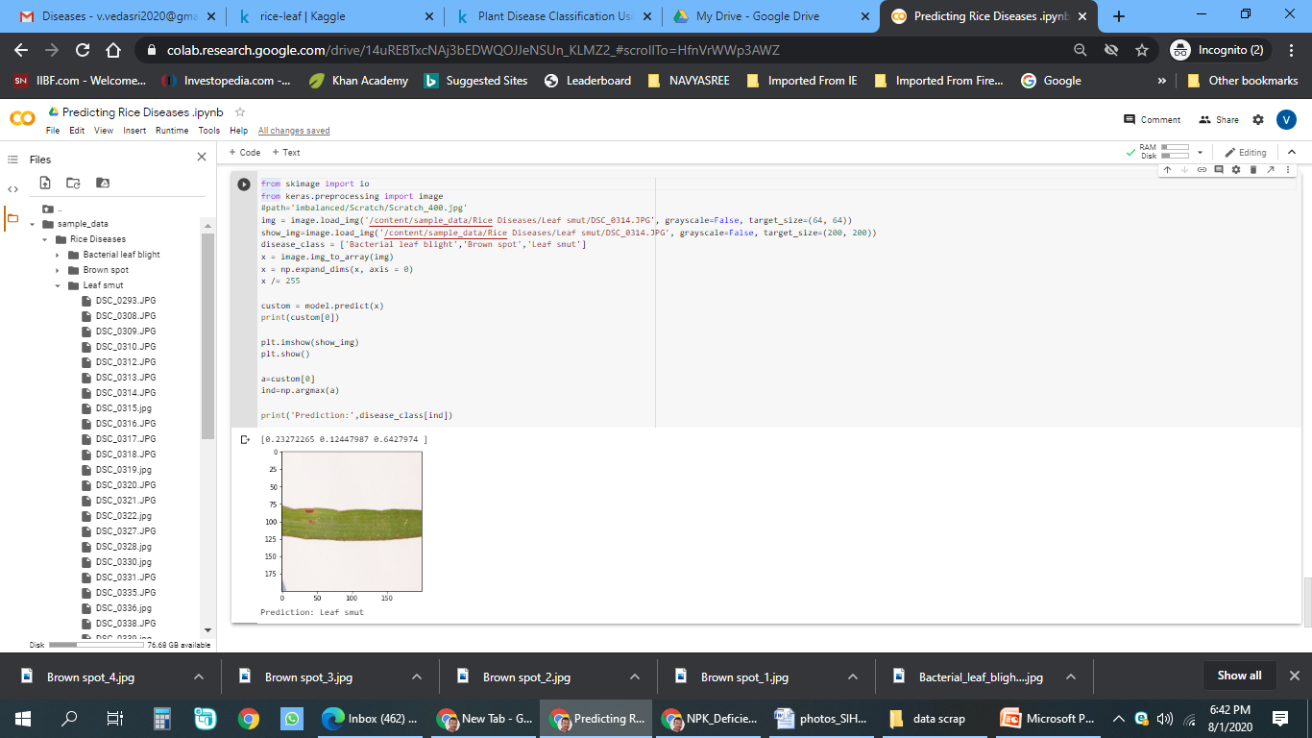
Emphasize your main benefit
Other benefits include
Nunc viverra imperdiet enim. Fusce est. Vivamus a tellus
Nunc viverra imperdiet enim. Fusce est. Vivamus a tellus

Slide 17

Novelty In This Project
Generally monsoon/ flood will effect the yield and crop progression, but by adding automation technology to this we can control and make useful for farming.
For example, Rice crop is a Aquatic plant , so it can be tolerate flooding for some time. Because in rice crop every stage we have to maintain certain level of water in the field , which helps to control the weed.
Guaranteed Irrigation.
Irrespective of land holding , farmers will get average yield.
Farmers will have overall control over the crop by using automation technology.
In drought, shift to cropping systems that are less water dependent than your current system.

Slide 18
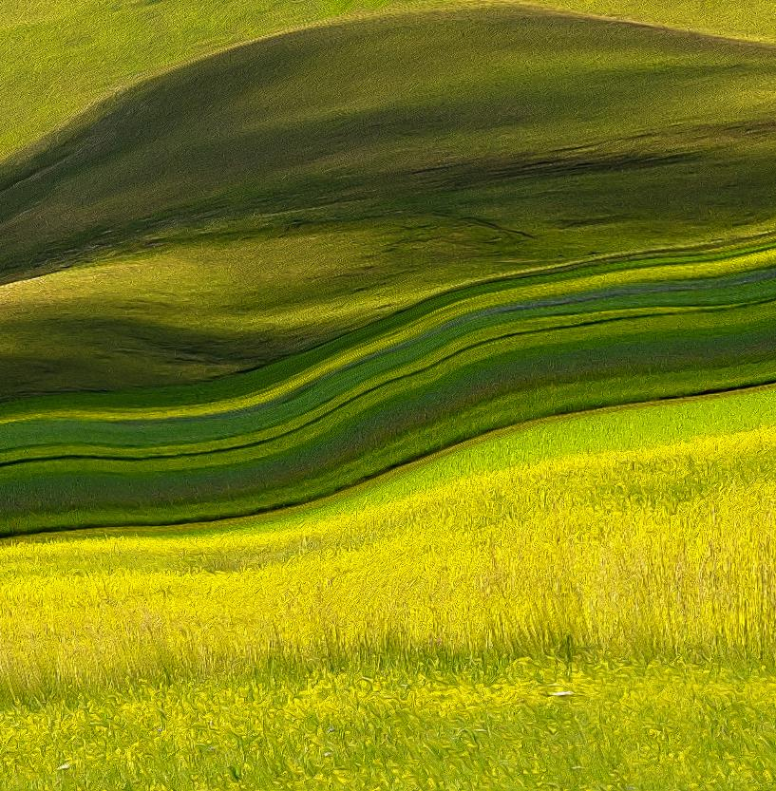
Conclusion
Empower the farmers with updated decision tools, automation technologies and apply adequate amount of water when required etc. improves the crop progression.

Slide 19
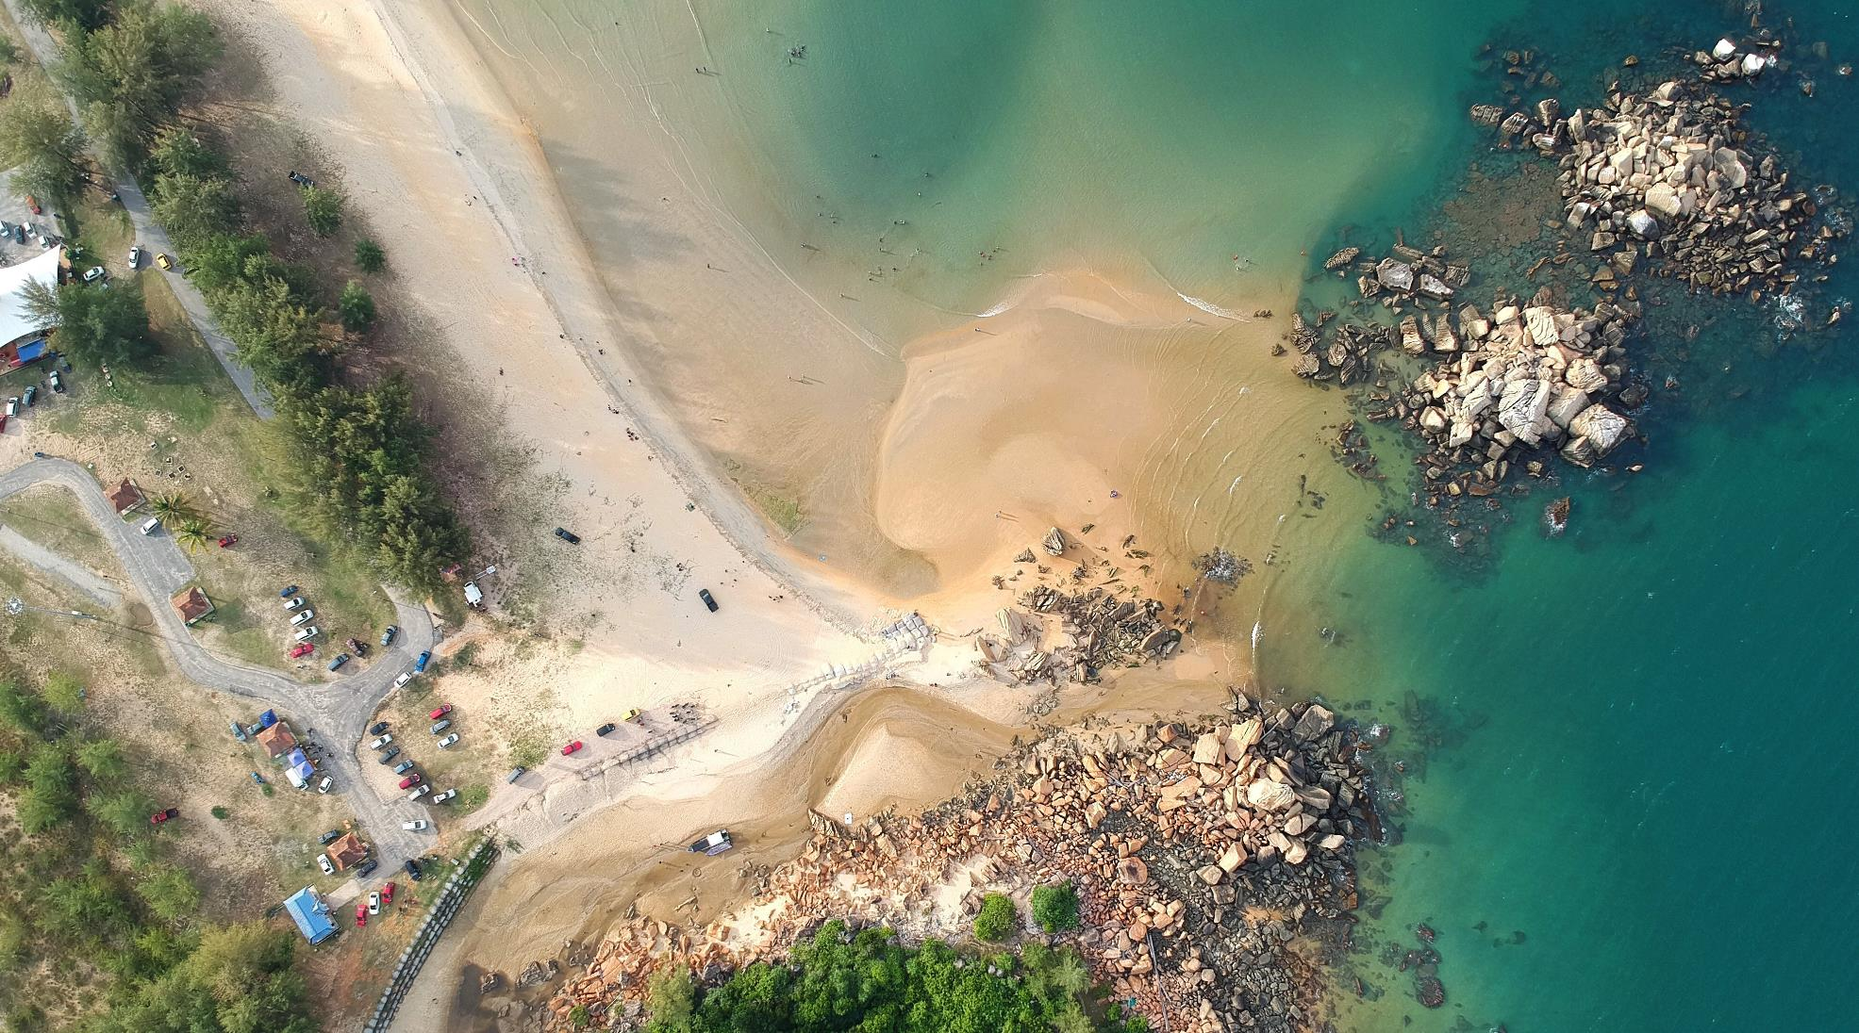
Thank You

